Slide 1
Relational DB design
Date of Presentation: 6/7/2023

Slide 2
Lesson 2: Creating an Entity-Relationship
Diagram (ERD)
Gerald Balekaki

Slide 3
Outline
ERD Process
Drawing ERD and Interpretation
case I: Business rules to ERD
case II: ERD to business rules
Reduction to relation schema
Relation schemas from ERDs

Slide 4
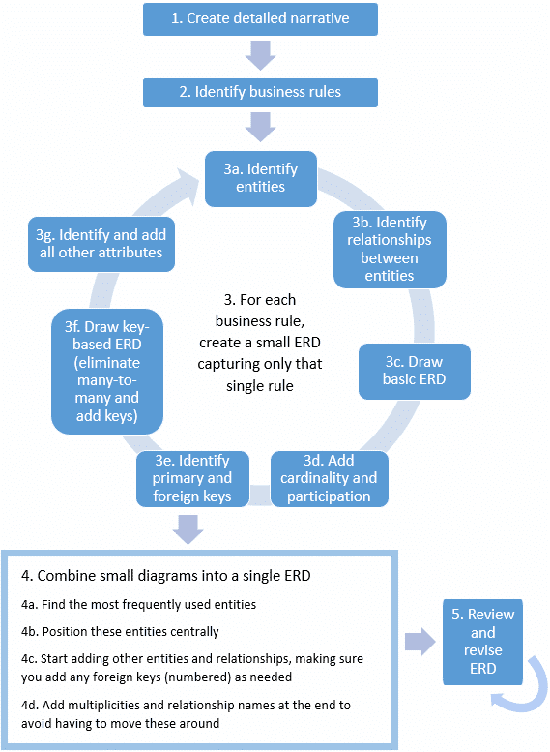
ERD Process
Process follows Five (5) main steps:
Step 1: Create detailed narrative
Step 2: Identify business rules
Step 3: For each business rule, create a small ERD
Step 4: Combine the small diagrams into a single ERD
Step 5: Review and revise ERD
Def:
A business rule is a statement that imposes some form of constraint on a specific aspect of the database (entity or relationship).
(Pellissier, 2023)

Slide 5
Case I:
Banking database

Slide 6
Case I: Banking database
Business Narrative
A customer can have at least two accounts, and customers must provide their name, address, and phone number. An account can belong to only one customer, and each account must have a type (e.g., savings, checking) and a balance. A transaction must be associated with a specific account. An account may have several transactions. A transaction is made at one branch, however a branch makes many transactions per day. Transactions must have a date and an amount. Branches must have a name and a location. Employees can work at at most one branch, and a branch employs many employees. Employees must have a name and a position within the bank. Each entity must have an identifier to uniquely identify a record in an entity.
Business rules for banking database:
A customer can have at least two accounts, and customers must provide their name, address, and phone number.
An account can belong to only one customer, and each account must have a type (e.g., savings, checking) and a balance.
A transaction must be associated with a specific account. An account may have several transactions.
A transaction is made at one branch, however a branch makes many transactions per day.
Transactions must have a date and an amount. Branches must have a name and a location.
Employees can work at at most one branch, and a branch employs many employees. Employees must have a name and a position within the bank.
Each entity must have an identifier to uniquely identify a record in an entity.

Slide 7
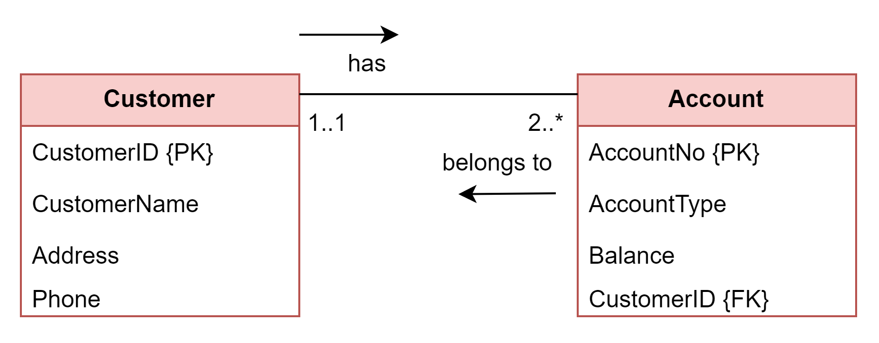
Case I: Banking database
[Small ERDs]
Business rules:
A customer can have at least two accounts, and customers must provide their name, address, and phone number.
An account can belong to only one customer, and each account must have a type (e.g., savings, checking) and a balance.
A transaction must be associated with a specific account. An account may have several transactions.
A transaction is made at one branch, however a branch makes many transactions per day.
Transactions must have a date and an amount. Branches must have a name and a location.
Employees can work at at most one branch, and a branch employs many employees. Employees must have a name and a position within the bank.
Each entity must have an identifier to uniquely identify a record in an entity.
ERD: Business rules 1.1 and 1.2

Slide 8
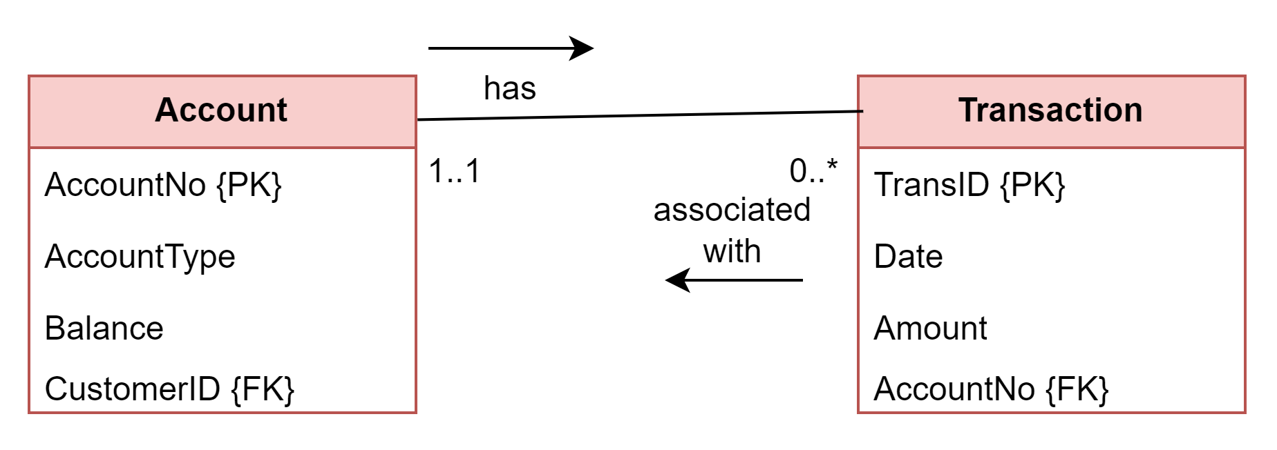
Case I: Banking database
[Small ERDs]
Business rules:
A customer can have at least two accounts, and customers must provide their name, address, and phone number.
An account can belong to only one customer, and each account must have a type (e.g., savings, checking) and a balance.
A transaction must be associated with a specific account. An account may have several transactions.
A transaction is made at one branch, however a branch makes many transactions per day.
Transactions must have a date and an amount. Branches must have a name and a location.
Employees can work at at most one branch, and a branch employs many employees. Employees must have a name and a position within the bank.
Each entity must have an identifier to uniquely identify a record in an entity.
ERD: Business rule 1.3

Slide 9
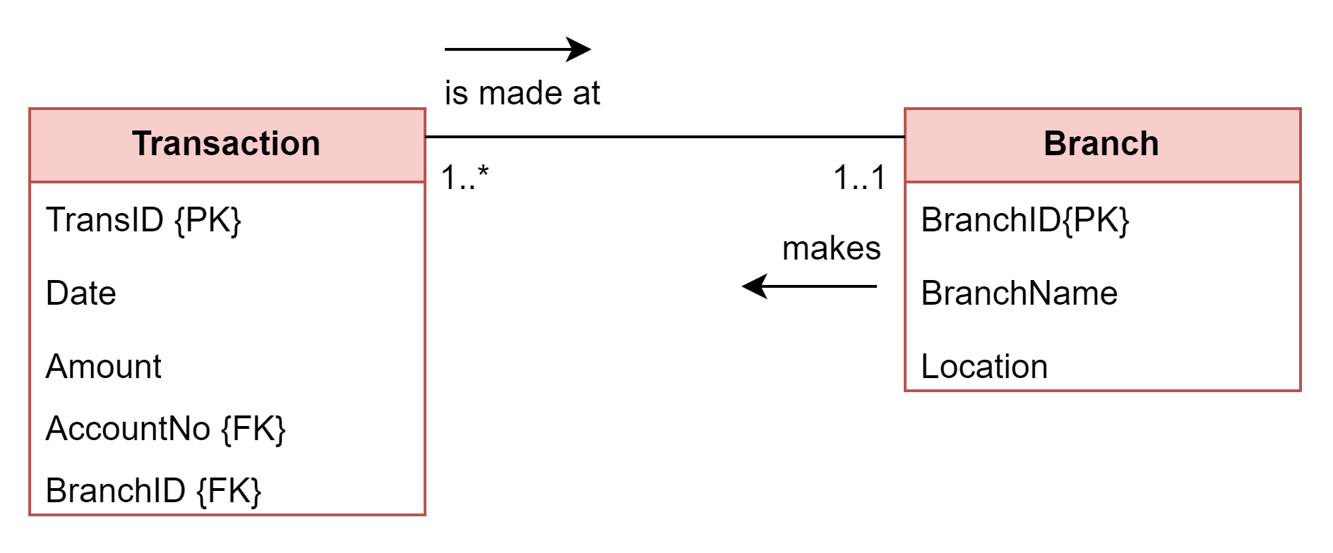
Case I: Banking database
[Small ERDs]
Business rules:
A customer can have at least two accounts, and customers must provide their name, address, and phone number.
An account can belong to only one customer, and each account must have a type (e.g., savings, checking) and a balance.
A transaction must be associated with a specific account. An account may have several transactions.
A transaction is made at one branch, however a branch makes many transactions per day.
Transactions must have a date and an amount. Branches must have a name and a location.
Employees can work at at most one branch, and a branch employs many employees. Employees must have a name and a position within the bank.
Each entity must have an identifier to uniquely identify a record in an entity.
ERD: Business rules 1.4 and 1.5

Slide 10
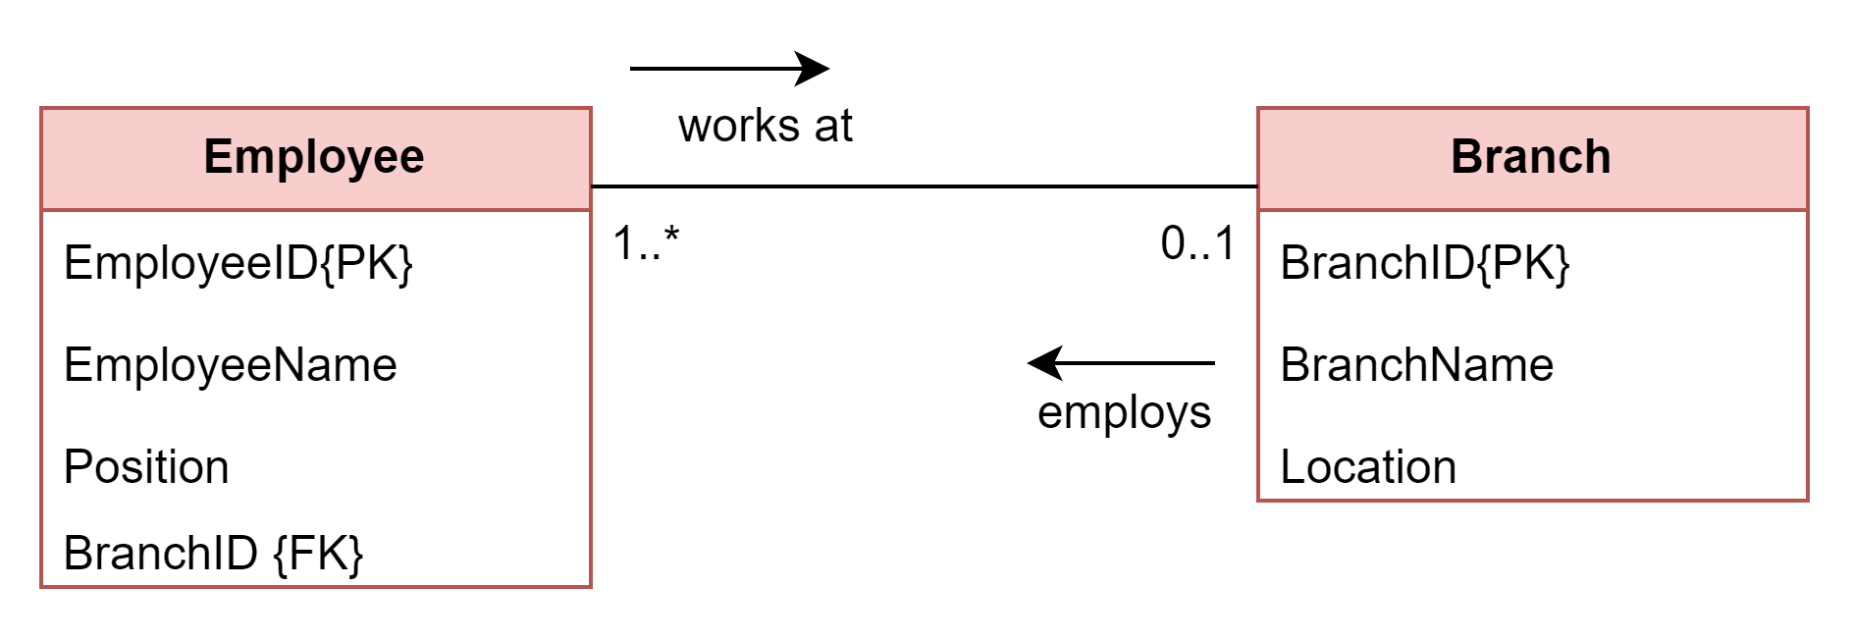
Case I: Banking database
[Small ERDs]
Business rules:
A customer can have at least two accounts, and customers must provide their name, address, and phone number.
An account can belong to only one customer, and each account must have a type (e.g., savings, checking) and a balance.
A transaction must be associated with a specific account. An account may have several transactions.
A transaction is made at one branch, however a branch makes many transactions per day.
Transactions must have a date and an amount. Branches must have a name and a location.
Employees can work at at most one branch, and a branch employs many employees. Employees must have a name and a position within the bank.
Each entity must have an identifier to uniquely identify a record in an entity.
ERD: Business rule 1.6

Slide 11
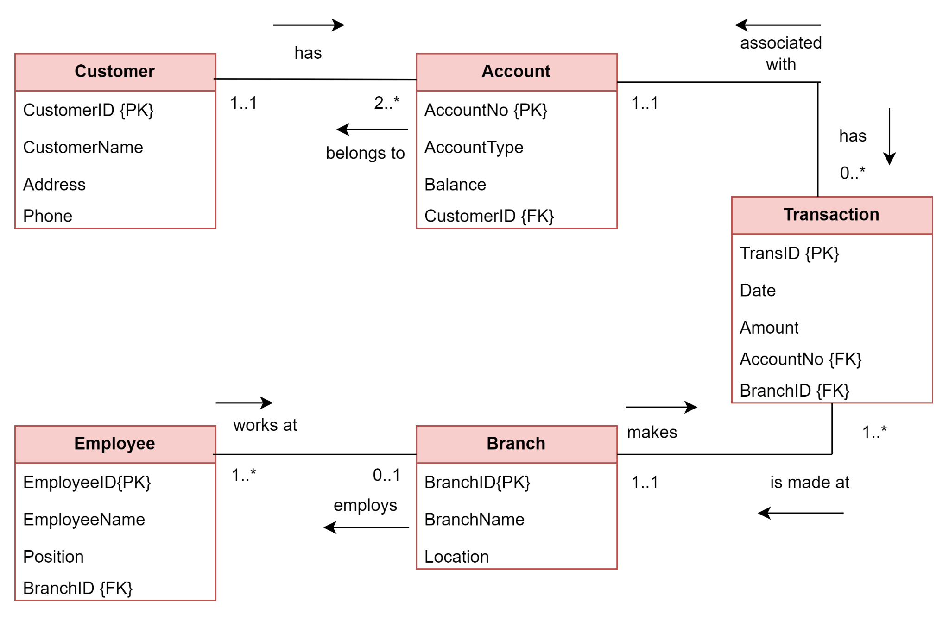
Case I: Banking database
[Combined ERDs]
Small ERDs:
Combined ERD

Slide 12
Solution: Business rules + ERD
Case I: Banking database
Business rules:
A customer can have at least two accounts, and customers must provide their name, address, and phone number.
An account can belong to only one customer, and each account must have a type (e.g., savings, checking) and a balance.
A transaction must be associated with a specific account. An account may have several transactions.
A transaction is made at one branch, however a branch makes many transactions per day.
Transactions must have a date and an amount. Branches must have a name and a location.
Employees can work at at most one branch, and a branch employs many employees. Employees must have a name and a position within the bank.
Each entity must have an identifier to uniquely identify a record in an entity.

Slide 13
Solution: Relation Schemas + ERD
Case I: Banking database
Relation schema for banking database:
Customer (CustomerID, CustomerName, Address, Phone)
Account (AccountNo, AccountType, Balance, CustomerID)
Transaction (TransID, Date, Amount, AccountNo, BranchID)
Branch (BranchID, BranchName, Location)
Employee (EmployeeID, EmployeeName, Position, BranchNo)

Slide 14
Case II:
CustomerOrder database

Slide 15
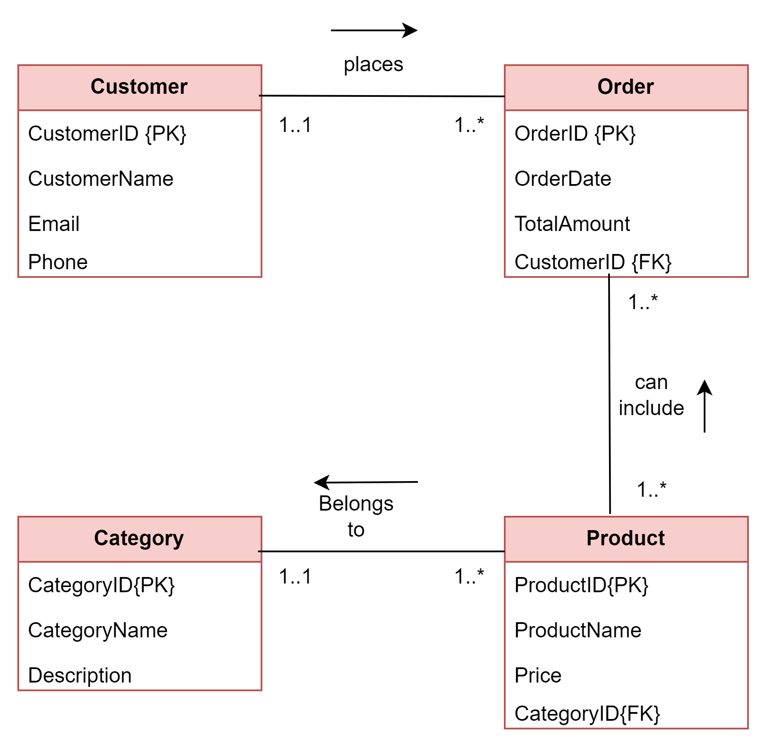
Business rules + ERD
Case II: CustomerOrder database
List all the business rules from the CustomerOrder ERD
?
?
?
?
?
?
?

Slide 16
Business rules + ERD
Case II: CustomerOrder database
List all the business rules from the CustomerOrder ERD
One customer places multiple (1 or more) orders. Each order is associated with only one (1 and only 1) customer.
Customer stores CustomerID, name of customer, Phone and email as attributes
Order has OrderID, date of order, and total amount as attributes
Each order can include multiple products, and each product can be part of multiple orders.
Product has ProductID, name of product, and price.
Each product belongs to a specific category, and a category can have multiple products.
Category consists of CategoryID, name and description fields.

Slide 17
Many-to-Many scenario
Case II: CustomerOrder database
How to deal with Many-to-Many (M:M) relationships
Each order can include multiple products, and each product can be part of multiple orders (Many-to-Many relationship between Order and Product).
Approach:
Introduce a bridge entity
can have attributes
PK {OrderID + ProductID}
Or use a surrogate key (new ID field in bridge entity)

Slide 18
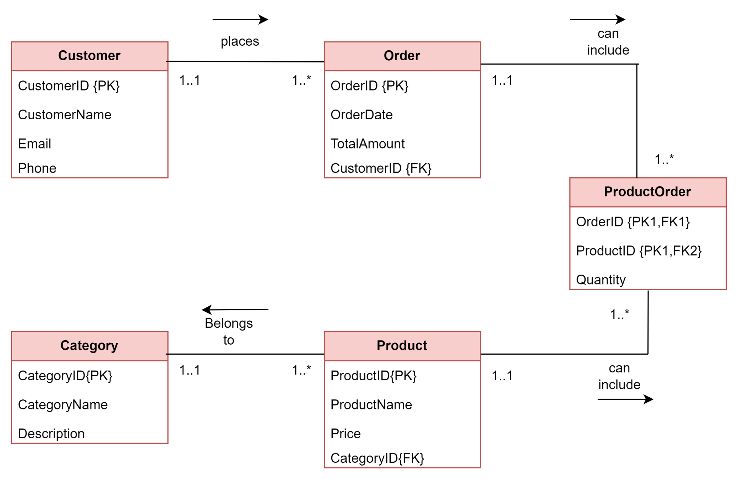
Solution: Business rules + ERD
Case II: CustomerOrder database
CustomerOrder database/business rules:
One customer places multiple (1 or more) orders. Each order is associated with only one (1 and only 1) customer.
Customer stores CustomerID, name of customer, Phone and email as attributes
Order has OrderID, date of order, and total amount as attributes
Each order can include multiple products, and each product can be part of multiple orders.
Product has ProductID, name of product, and price.
Each product belongs to a specific category, and a category can have multiple products.
Category consists of CategoryID, name and description fields.
PK1:
OrderID + ProductID

Slide 19
Solution: Relation Schemas + ERD
Case II: CustomerOrder database
Relation schemas for CustomerOrder database:
Customer (CustomerID, CustomerName, Email, Phone)
Order (OrderID, OrderDate, TotalAmount, CustomerID)
Product (ProductID, ProductName, Price, CategoryID)
Category (CategoryID, CategoryName, Description)
ProductOrder (ProductID, OrderID)
Note: A bridge entity can have other attributes: e.g., Quantity of products ordered.
ProductOrder (ProductID, OrderID, Quantity)

Slide 20
Activities
Find enrichment activities on how to create ERDs in the assessment session
Attempt activities 2.2 to 2.5

Slide 21
Summary
ERD Process
Drawing ERD and Interpretation
case I: Business rules to ERD
case II: ERD to business rules
Reduction to relation schema
Relation schemas from ERDs
🡺NEXT
Extended ERD (EERD)

Slide 22
References
Pellissier, H. (2023). The Process - A Brief Description. [online] Available at: https://www.pellissier.co.za/wp-content/uploads/erds/content/index.html#/lessons/l2aG_0RrVcYOIg5p6FyhM4g6pg0hNJGZ [Accessed 6 Jun. 2023].

